Slide 1
E-Commerce Sales & Customer Analytics Dashboard
Shristi
Imarticus Learning SQL | Power BI Project

Slide 2
Project Overview
This project analyzes an e-commerce dataset to understand sales and customer behavior.
SQL was used to perform data analysis and calculate key metrics.
Power BI was used to create interactive dashboards.
The goal was to convert raw data into meaningful business insights.
Focused on sales, customers, and order performance

Slide 3
Business Objectives
Analyze overall sales performance.
Identify top customers and high-performing products.
Track cancelled and late deliveries.
Understand repeat vs one-time customers.
Generate insights that can help improve business decisions.

Slide 4
Dataset Description
The dataset contains information about customers, orders, products, and deliveries.
It includes details like order date, product category, quantity, payment mode, and delivery status.
Multiple tables were connected using relationships in Power BI.
A one-to-many relationship was used between Customers → Orders and Orders → Order Details.

Slide 5
SQL Analysis
Used JOIN operations to combine multiple tables.
Applied GROUP BY and aggregation functions to calculate revenue and KPIs
Identified repeat and one-time customers.
Analyzed cancellation rate and order performance.
Identified top customers by revenue .
Calculating average orders.
SQL helped in converting raw data into structured business insights.

Slide 6
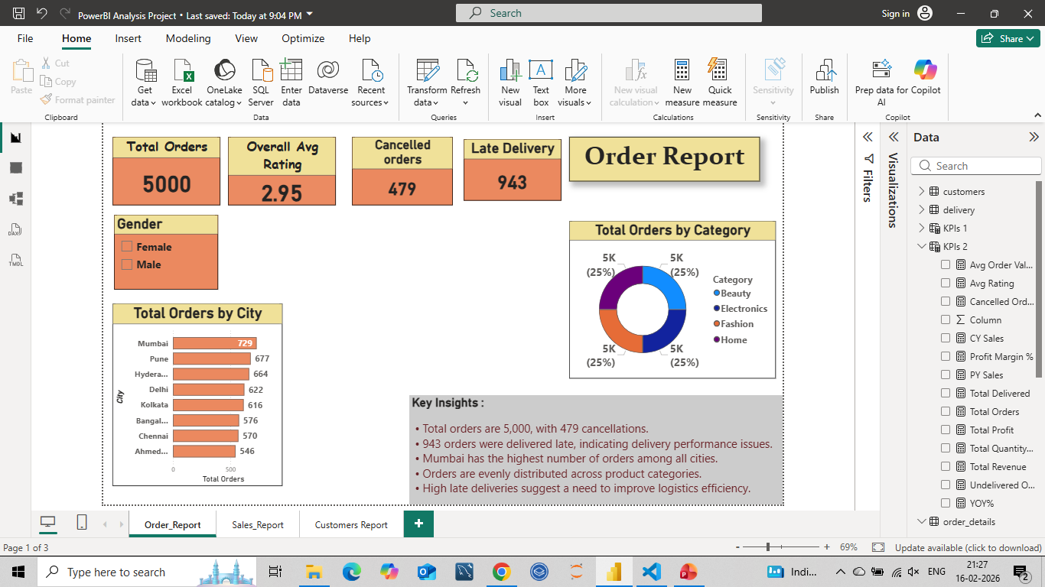
Order Report Analysis
Analyzed total orders and cancellation trends.
Tracked late deliveries to understand service performance.
Identified order distribution across cities and categories.
Helped evaluate operational efficiency.

Slide 7
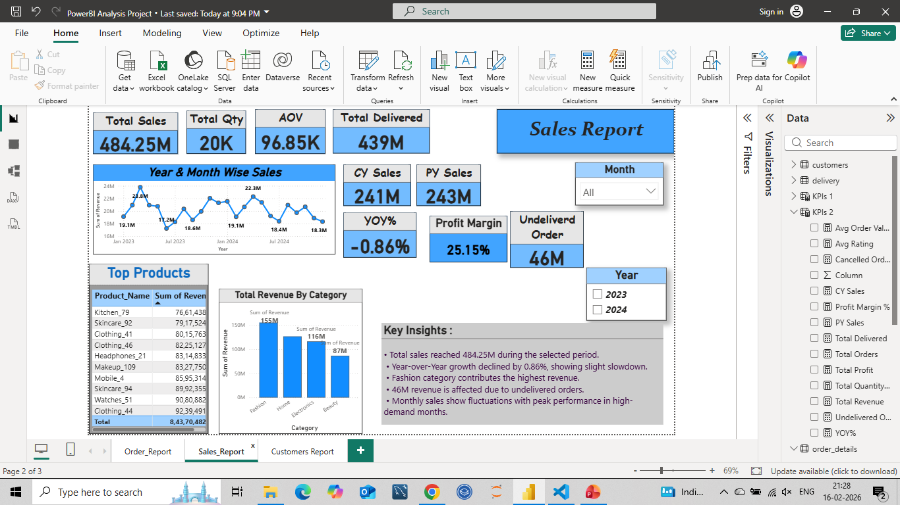
Sales Performance Analysis
Analyzed total sales and quantity sold.
Calculated Average Order Value (AOV).
Studied monthly sales trends and year-over-year growth.
Identified top-performing products and categories.
Calculated Profit and Profit Margin % to evaluate business profitability.

Slide 8
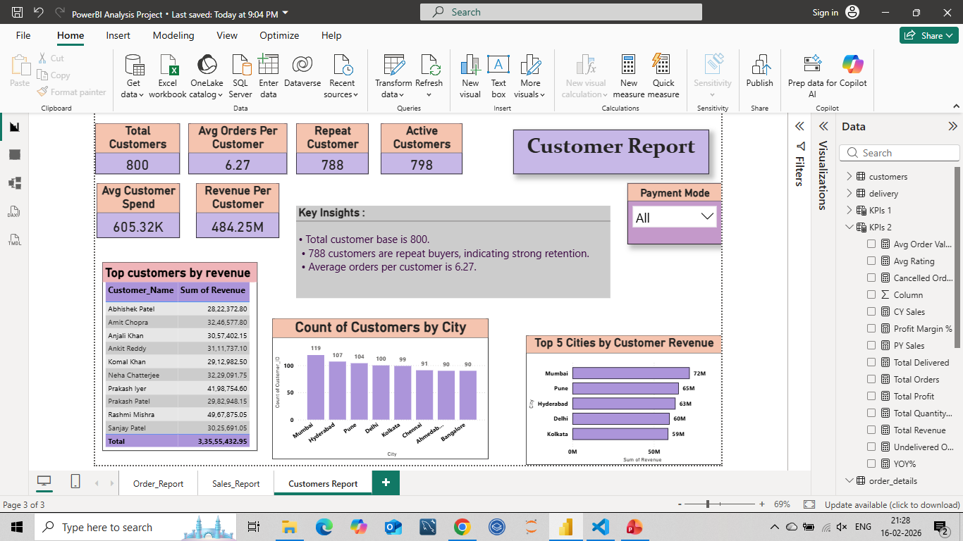
Customer Analysis
Identified total and active customers.
Analyzed repeat vs one-time customers.
Calculated average orders per customer.
Highlighted top customers based on revenue contribution.

Slide 9
Key Insights
Top customers contribute a significant portion of total revenue, highlighting the importance of customer retention strategies.
Repeat customers generate higher lifetime value compared to one-time buyers.
Certain product categories consistently drive higher sales.
Monitoring cancellations and late deliveries is important for customer satisfaction.
Sales show seasonal trends across different months.

Slide 10
Challenges Faced
Understanding and creating proper relationships between tables.
Writing complex SQL joins across multiple tables.
Creating accurate DAX measures in Power BI.
Interpreting business KPIs correctly.
Designing a clean and readable dashboard layout.

Slide 11
What I Learned
How SQL is used to analyze structured business data.
How to connect multiple tables using proper data modeling.
How to calculate KPIs like revenue, AOV, and customer lifetime value.
How to design interactive dashboards in Power BI.

Slide 12
Conclusion
This project demonstrates an end-to-end data analysis workflow.
SQL was used to extract and analyze business insights.
Power BI was used to visualize KPIs and trends.
This project strengthened my analytical thinking and helped me understand how data supports business decision-making.

Slide 13
THANK YOU
THANK YOU

